Slide 1
Uninformed/Blind Search
BBM 405 – Fundamentals of Artificial Intelligence
Pinar Duygulu
Hacettepe University
Slides are mostly adapted from AIMA, MIT Open Courseware,
Manuela Veloso(CMU) and
Svetlana Lazebnik (UIUC)
CS461 Artificial Intelligence © Pinar Duygulu
Spring 2008

Slide 2
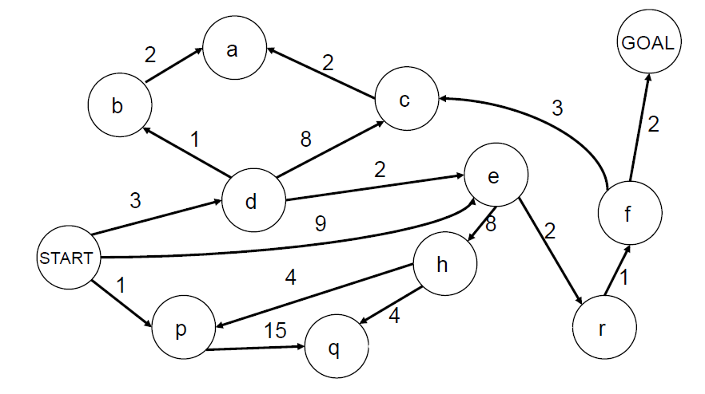
Search with varying step costs
BFS finds the path with the fewest steps, but does not always find the cheapest path
Notes:
Up to now we only discussed the problems with path cost equal to 1
However, as in the Romania map example path cost from one node to another may vary
Breadth first search finds the shallowest goal state,
But with varying path costs, thi smay not be the least cost solution.

Slide 3
Uniform-cost search
For each frontier node, save the total cost of the path from the initial state to that node
Expand the frontier node with the lowest path cost
Implementation: frontier is a priority queue ordered by path cost
Equivalent to breadth-first if step costs all equal
Equivalent to Dijkstra’s algorithm in general
Notes:
An alternative search strategy is uniform cost search which modifies the breadth first by always expanding the lowest cost node on the fringe.
Now the frontier is a priority queue, which is sorted according to path cost from lowest to highest
When step cost is 1, or all equal, uniform cost is equivalent to breadth first search

Slide 4
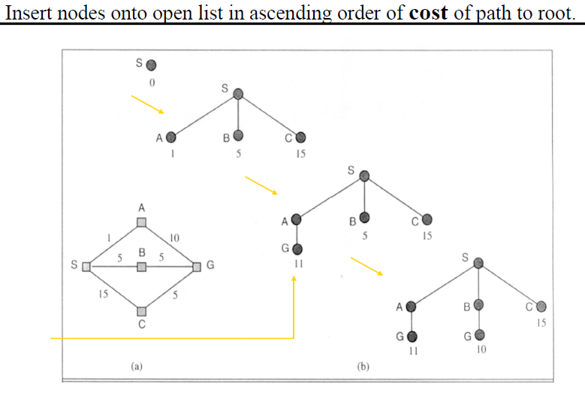
Uniform-cost search
Taken from http://www.cs.nott.ac.uk/~gxk/courses/g5aiai/003blindsearches/blind_searches.htm
CS461 Artificial Intelligence © Pinar Duygulu
Spring 2008
Notes:
Let’s consider a simple example
S has three successors A B and C
Which are ordered as A B C according to their path costs
So we first expand A
We can reach G through A with path cost 11
However in our frontier we have B which has a smaller cost than G
Therefore we continue by expanding B
Now we reached G again through B with path cost 10
Since C’s cost is larger than the cost of G reached from B, we now choose G and expand it
So we have found the solution with a cost of 10, which is the minimum
As you see, we had two G’s in our frontier, and chose the one with least cost.
Any node may have multiple copies in the queue with different path costs.

Slide 5
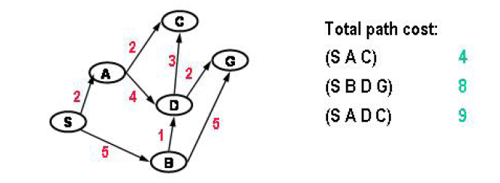
Uniform cost search
Each link has a length or cost (which is always greater than 0)
We want shortest or least cost path
CS461 Artificial Intelligence © Pinar Duygulu
Spring 2008
Notes:
Now, a little harder example
Each node’s path cost is calculated as the sum of all step costs though the path
For example cost of C is 2+2 = 4 through A
But the cost for C is 5+1+3 = 9 through B and D

Slide 6
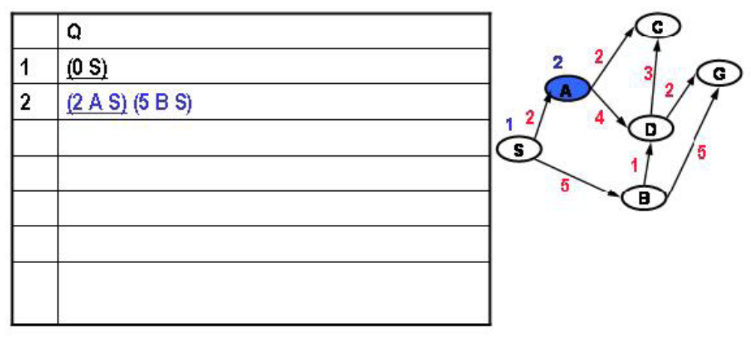
Uniform cost search
CS461 Artificial Intelligence © Pinar Duygulu
Spring 2008
Notes:
In order to handle the confusion we will represent each node with the path from the start state
For example A will be represented as (A S)
We expand S, and put A and b into the queue with costs 2 and 5
Then being the cheapest we expand A

Slide 7
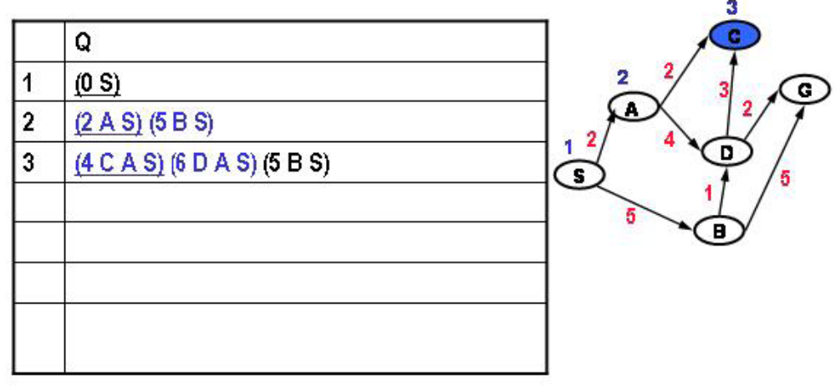
Uniform cost search
CS461 Artificial Intelligence © Pinar Duygulu
Spring 2008

Slide 8
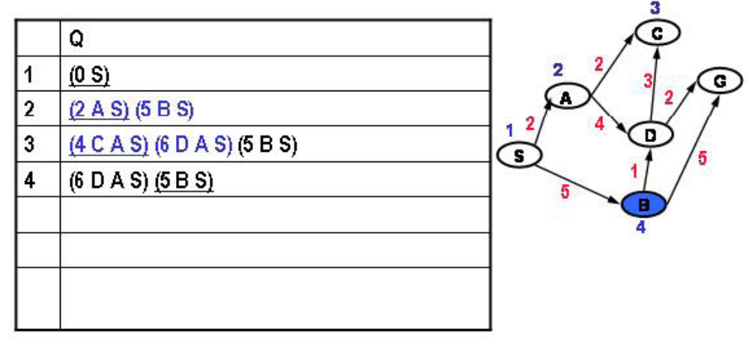
Uniform cost search
CS461 Artificial Intelligence © Pinar Duygulu
Spring 2008
Notes:
And put C with path cost 2+2 = 4
And D with path cost 2+4 = 6
Now unlike breadth first search, we do not expand b but c with the least cost
It is a dead end
Therefore we expand B now

Slide 9
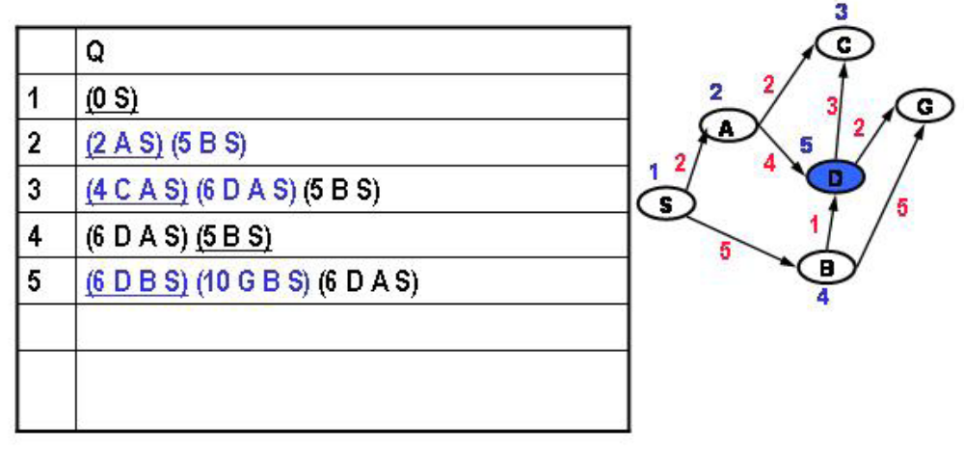
Uniform cost search
CS461 Artificial Intelligence © Pinar Duygulu
Spring 2008

Slide 10
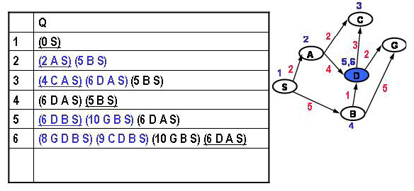
Uniform cost search
CS461 Artificial Intelligence © Pinar Duygulu
Spring 2008
Notes:
We can reach D again through B with path cost 5+1=6
And G with path cost 5+5=10
We have two D’s in the queue now
One through A , and one through B
Now, since both have the same cost we can choose any of them, and discard the other
From D we can reach C again with cost 6+3 = 9
And G with cost 6+2 = 8
Remember that we had another G through b with cost 10

Slide 11
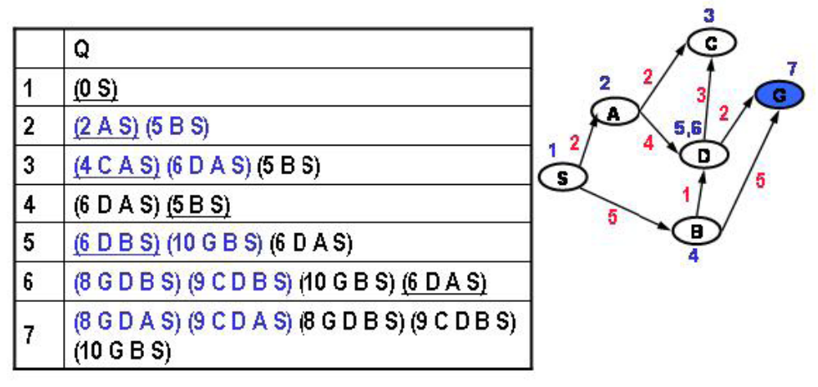
Uniform cost search
CS461 Artificial Intelligence © Pinar Duygulu
Spring 2008
Notes:
Now, the least cost node is G through D with cost 8
Then we can expand it

Slide 12
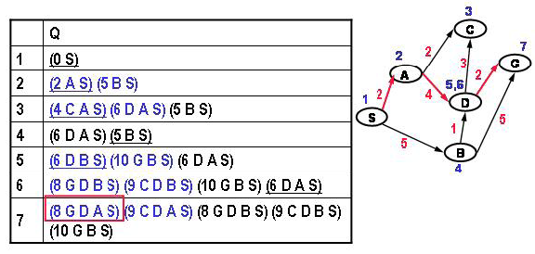
Uniform cost search
CS461 Artificial Intelligence © Pinar Duygulu
Spring 2008
Notes:
So the path to the goal state is S A D G
It could be S B D G as well but we chose alphabetical order, it doesn’t matter much

Slide 13
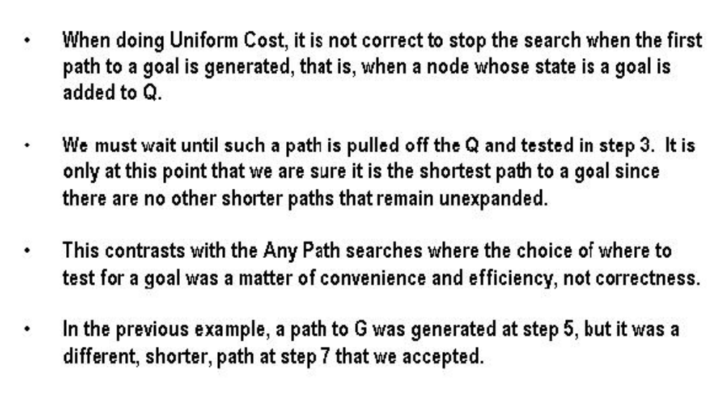
Why not stop on the first goal
CS461 Artificial Intelligence © Pinar Duygulu
Spring 2008
Notes:
As you have seen through the examples, we did not stop when we put the goal to the queue, that is when we generated it
Rather we stopped when we take the goal state from the queue to expand it
Because we can only be sure that a node is cheapest when we take it from the queue
Therefore, the least cost solution can be in deeper levels.

Slide 14
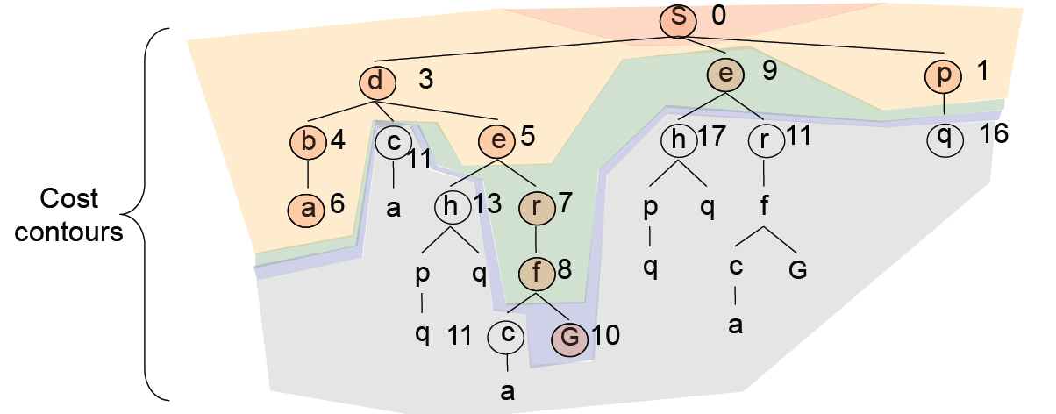
Uniform-cost search example
Expansion order:
(S,p,d,b,e,a,r,f,e,G)
Notes:
In this example the colors show the order of expansion
Fırst we expand S
The order of nodes is P d and E with costs 1, 3, and 9
We expand P
Since Q is 16, we expand D
B E and C are put into queue with costs 7, 8 and 11
We expand B and put A with cost 6, which is minimum but it is a dead end
So we expand E and put R and H with costs 7 and 13
Now we expand R, put F with 8, expand F and put G with 10
We expand E now and put R and H with 11 and 17
Now G is the minimum in the queue, we expand it, and found the cheapest path
Through
S D E R F G
By the nodes being expanded in order
S P D B E A R F E G

Slide 15
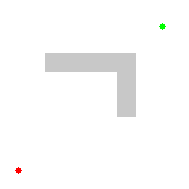
Another example of uniform-cost search
Source: Wikipedia
Notes:
Let’s see what happens in this maze example when we try to reach from RED to GREEN with a barrier shown in grey

Slide 16
Properties of uniform-cost search
Expand least-cost unexpanded node
Implementation:
  fringe = queue ordered by path cost
Equivalent to breadth-first if step costs all equal
Complete?
  Yes, if step cost is greater than some positive constant ε (we don’t want infinite sequences of steps that have a finite total cost)
Optimal?
  Yes
Notes:
Now, is it optimal
Yes
When certain conditions are met, the first solution that is found is guaranteed to be the cheapest solution
Because if there were a cheaper path that was a solution, it would have been expanded earlier
The condition is simple
The cost of a path must never decrease as we go along the path
That is the step cost should be greater than some positive constant epsilon
If every step has a nonnegative cost, then the cost of the path can never decrease along the path
and uniform cost search can find the cheapest path without exploring the whole search tree
But if some step has a negative cost then nothing but an exhaustive search of all nodes would find the optimal solution
Because we would never know when a path will result in a high negative cost and thus became the best path
If the condition is satisfied the uniform is complete as well.

Slide 17
Optimality of uniform-cost search
Graph separation property: every path from the initial state to an unexplored state has to pass through a state on the frontier
  Proved inductively
Optimality of UCS: proof by contradiction
  Suppose UCS terminates at goal state n with path cost g(n) but there exists another goal state n’ with g(n’) < g(n)
  By the graph separation property, there must exist a node n” on the frontier that is on the optimal path to n’
  But because g(n”) ≤ g(n’) < g(n),
  n” should have been expanded first!
start
frontier
n’’
n’
n
Notes:
We will show the optimality of uniform cost search using proof by contradiction.
Graph separation property tell us that every path from the initial state to an unexplored state has to pass through a state on frontier
We represent the path cost of a state n as g(n)
Suppose that
Uniform cost search terminates at a goal state with path cost g(n)
But there exist a cheaper path through n’ with path cost g(n;) less than g(n)
By the graph separation property there must exist a node n’’ on the frontier
That is on the optimal path to n’
However in this case g(n’’) < g(n’) and g(n)
But then n’’ should have been expanded first
But it wasn’t
Therefore there cannot be such n’

Slide 18
Uniform-cost search
Complete? Yes, if step cost ≥ ε
Time? # of nodes with pathn cost g ≤ cost of optimal solution,
O(b^{ceiling(C*/ ε)}) where C* is the cost of the optimal solution
This can be greater than O(b^{d}): the search can explore long paths consisting of small steps before exploring shorter paths consisting of larger steps
Space? # of nodes with g ≤ cost of optimal solution, O(b^{ceiling(C*/ ε)})
Optimal? Yes – nodes expanded in increasing order of g(n)
CS461 Artificial Intelligence © Pinar Duygulu
Spring 2008
Notes:
What about the space and time complexity of uniform cost search?
Since we define the time and space complexity through number of nodes expanded,
In this case it is the nodes with g(n) ≤ C* where C* is the cost of optimal solution
We can divide the cost of optimal solution C* to epsilon to find an approximate deprh, and then applying it for braching factor b
So that we can say that it is approximately O (b^C*/epsilon)

Slide 19
Review: Uninformed search strategies
Algorithm | Complete? | Optimal? | Time complexity | Space complexity
BFS
DFS
IDS
UCS
Yes
If all step
costs are equal
O(b^{d})
O(b^{d})
No
No
O(b^{m})
O(bm)
Yes
If all step
costs are equal
O(b^{d})
O(bd)
Yes
Yes
Number of nodes with g(n) ≤ C*
  b: maximum branching factor of the search tree
  d: depth of the optimal solution
  m: maximum length of any path in the state space
  C*: cost of optimal solution
  g(n): cost of path from start state to node n
Notes:
Let’s now summarise all the uninformed search strategies that we have learned
Now ask yourselves these questions.
When is UCS equivalent to BFS?
Can the complexity of UCS exceed the complexity of BFS?
How to make DFS complete?
When is DFS better than BFS?

